Slide 1

SPAMMER DETECTION AND FAKE USER IDENTIFICATION ON SOCIAL NETWORKS
PRESENTATION BY
G.Karthik 208X1A0536
K.Bhargav 208X1A0548
D.Punith Reddy 208X1A0527
G.K.Gireesh 208X1A0541
B.Janardhana 208X1A0512
Under the guidance of HOD PRINCIPAL
MRS .V.Subhasini Dr.A.Sathiyaraj Dr.N.Sudhakar reddy,
M.Tech,Ass.professor B.Tech, M.E,M.B.A Ph.D,professor. B.E,M.Tech,PH.D,MISTE.
DEPARTMENT OF COMPUTER SCIENCE AND ENGINEERING

Slide 2
Contents
Introduction
Abstract
Existing System
Proposed System
System Requirements
UML diagrams
Modules
Screenshots
Conclusion
References

Slide 3
INTRODUCTION
Twitter has rapidly become an online source for acquiring real time information about users.
Twitter is an online social network(OSN) where users can share anything and everything , such as news , opinions.
Recently , the detection of spam in social networking sites attracted the attention of researchers .
Spam detection is a difficult task in maintaining the security of social networks . Twitter spammers have various objectives , such as spreading invalid information , fake news, rumours , and spontaneous messages.

Slide 4
ABSTRACT
Social networking sites engage millions of users around the world . The users interaction with this social sites . The users' interactions with these social sites, such as Twitter and Facebook have a tremendous impact and occasionally undesirable repercussions for daily life. The prominent social networking sites have turned into a target platform for the spammers to disperse a huge amount of irrelevant and deleterious information. Moreover, a taxonomy of the Twitter spam detection approaches is presented that classifies the techniques based on there ability to detect Fake content,Spam based on URL , Spam in trending topics and Fake users.

Slide 5
EXISTING SYSTEM
In existing system , they had used matrix factorization method to detect spammers on twitter and also performed experiments on the real world twitter world dataset ,that is UDI (unique device identifier).
Later , they had used hidden markov model for filtering the spam related to only recent time topics.
Then they presented a technique by using random forest algorithm to recognize spammer insiders.

Slide 6
DISADVANTAGES:
There is no filtering system based on a preprocessing schedule and on Naive Bayes algorithm to discard the tweets containing inaccurate information.
Less security due No URL Based Spam Detection.
No efficient methods are used.
No real time data are used.
More complex.

Slide 7
PROPOSED SYSTEM
The proposed taxonomy is categorized into four main classes, namely,
Fake content
URL based spam detection
Detecting spam in trending topics
Fake user identification.
Each category of identification methods relies on a specific model, technique, and detection algorithm.
In this project we used Navies Bayes classifier and regression predicton model.

Slide 8
ADVANTAGES
There is a filtering system based on preprocessing schedule.
There is URL based Spam detection.
Tested with real time datas.
Less complex
We used navie bayes classifier to classify unwanted data.

Slide 9
MODELS USED: Navies Bayes Classifier
The Naïve Bayes classifier is a supervised machine learning algorithm, which is used for classification tasks, like text classification.
One of the frequently used algorithm to detect spam is naïve bayes algorithm which is based on the probabilistic model.
The classifier is quite fast ad memory efficient.
Regression prediction model
It is one of the most used regression algorithms in machine learning.
A significant variable from the dataset ischosen to predict the output variables(future values).

Slide 10
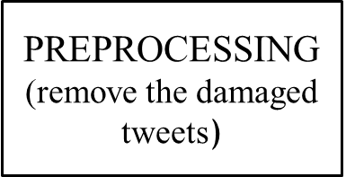
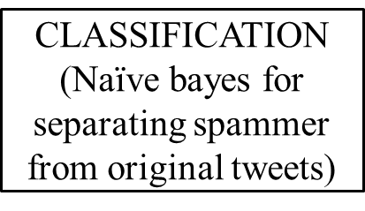
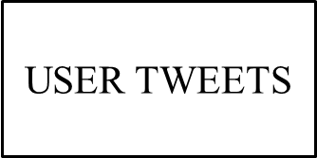
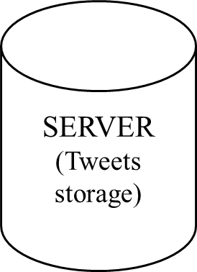
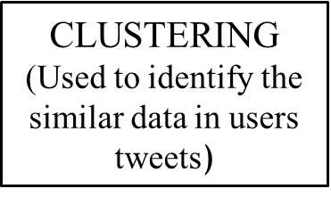

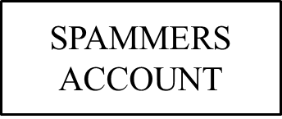
SYSTEM ARCHITECTURE

Slide 11
SYSTEMS REQUIREMENTS AND SPECIFICATION
Hardware Requirements:
System : intel i5 core
Hard Disk : 512 GB
Ram : 8 GB
Software Requirements :
Coding Language : Python.
Operating system : windows 10/11
Designing : Html ,CSS , Javascript
Web Server : sqlYog

Slide 12
MODULES:
Admin
User

Slide 13
MODULES DESCRIPTION:
Admin :
In this module, the Admin has to login by using valid user name and password.
Admin will categorize the users into spam accounts and fake user or normal user based on the content they post.
The categorization is full based on words we use.
User :
In this module, there are n numbers of users are present. User should register before doing some operations.
After registration successful he has to wait for admin to authorize him and after admin authorized him.
User can post tweets ,give reviews and etc.,

Slide 14
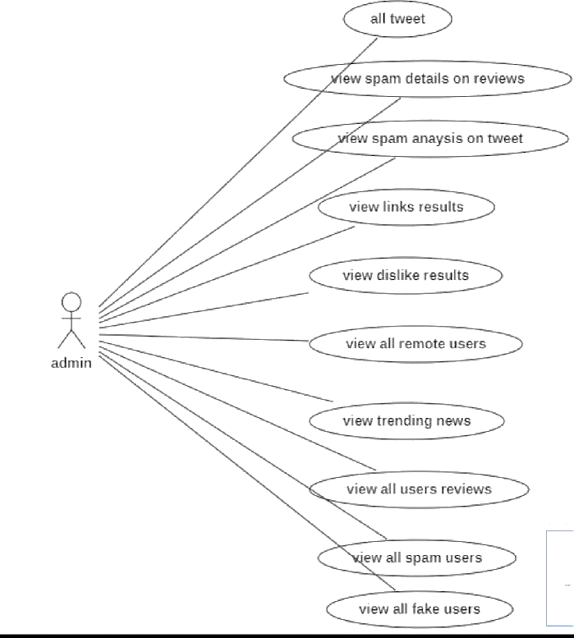
USE CASE DIAGRAM:
View like results

Slide 15
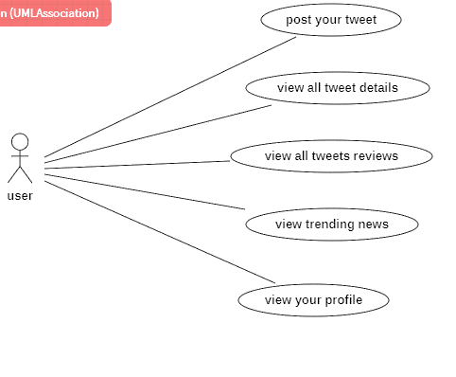

Slide 16
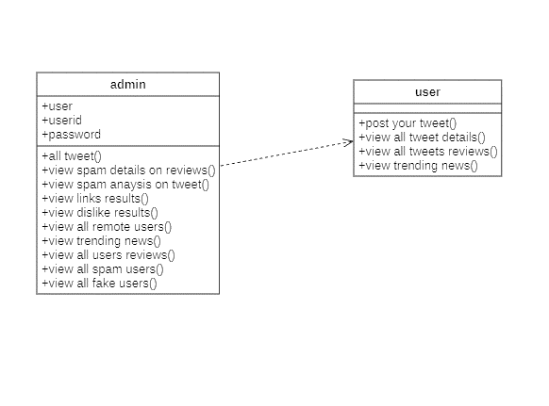
CLASS DIAGRAM;

Slide 17
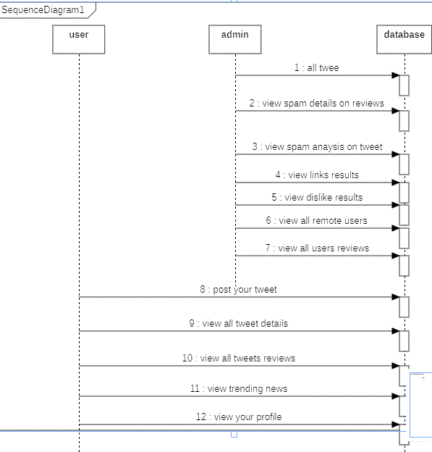
SEQUENCE DIAGRAM:
FF

Slide 18
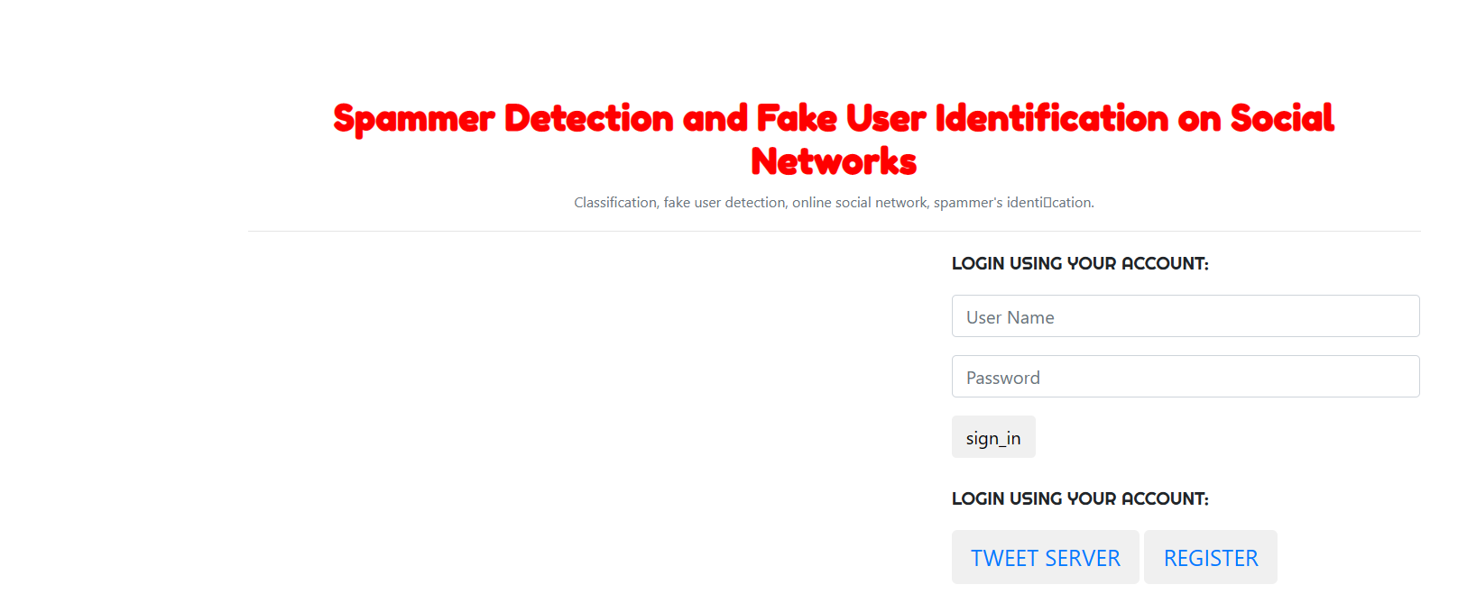
OUTPUT SCREENSHOTS

Slide 19
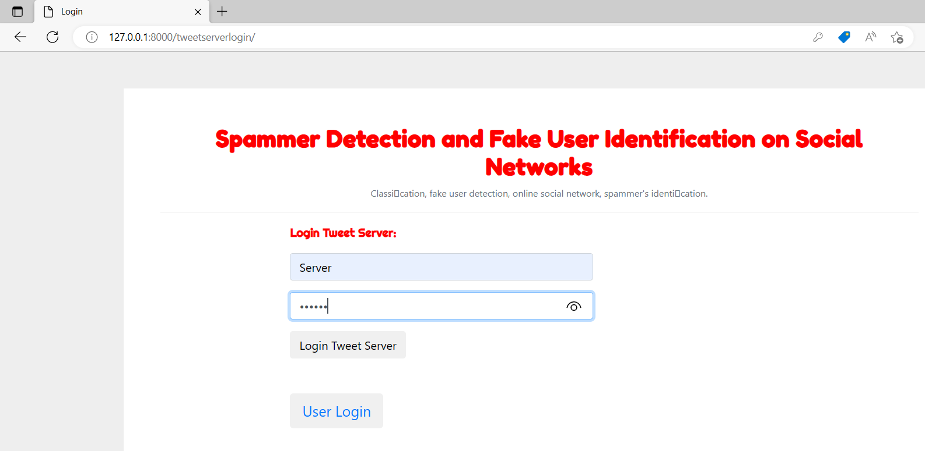

Slide 20
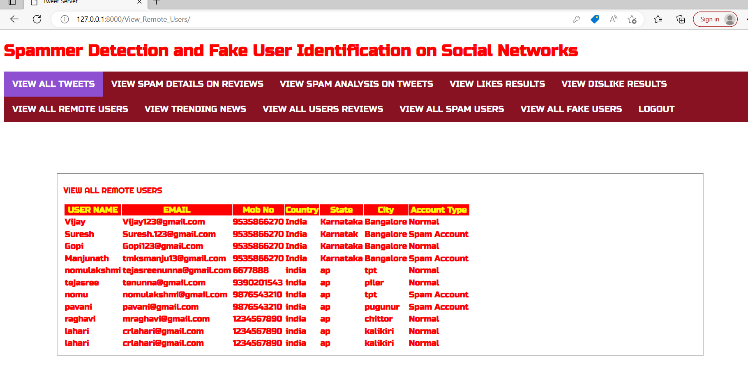

Slide 21
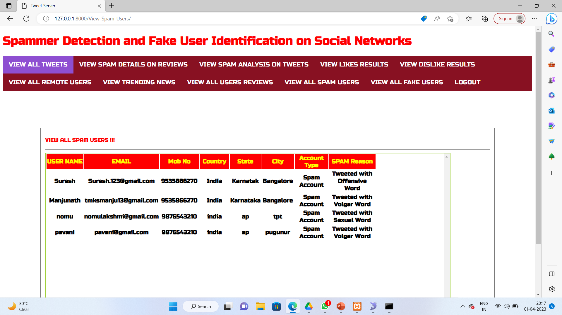

Slide 22
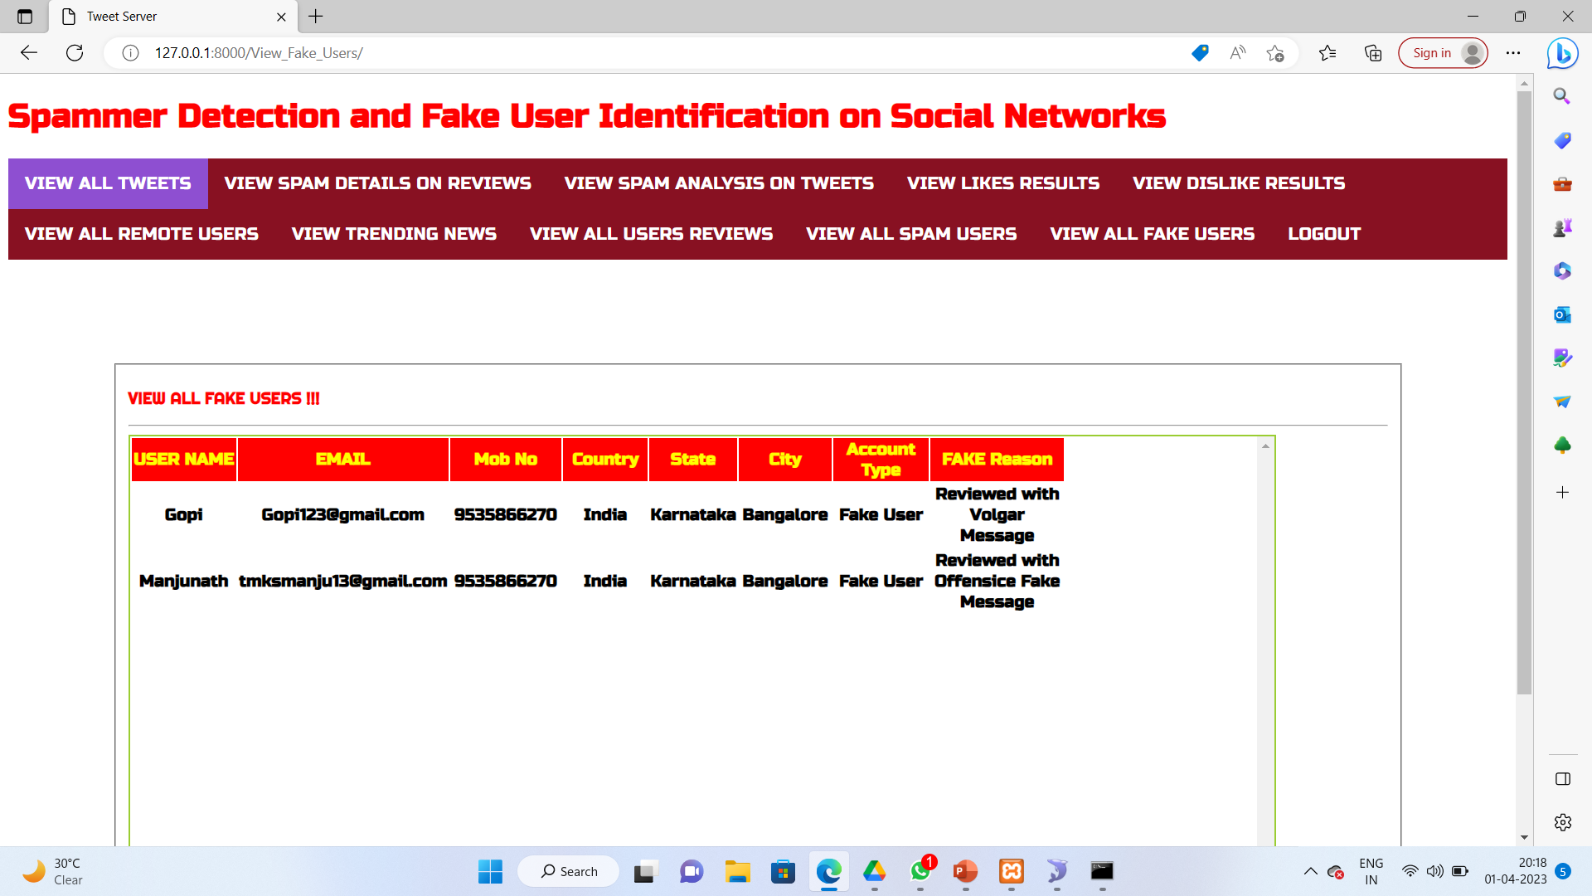

Slide 23
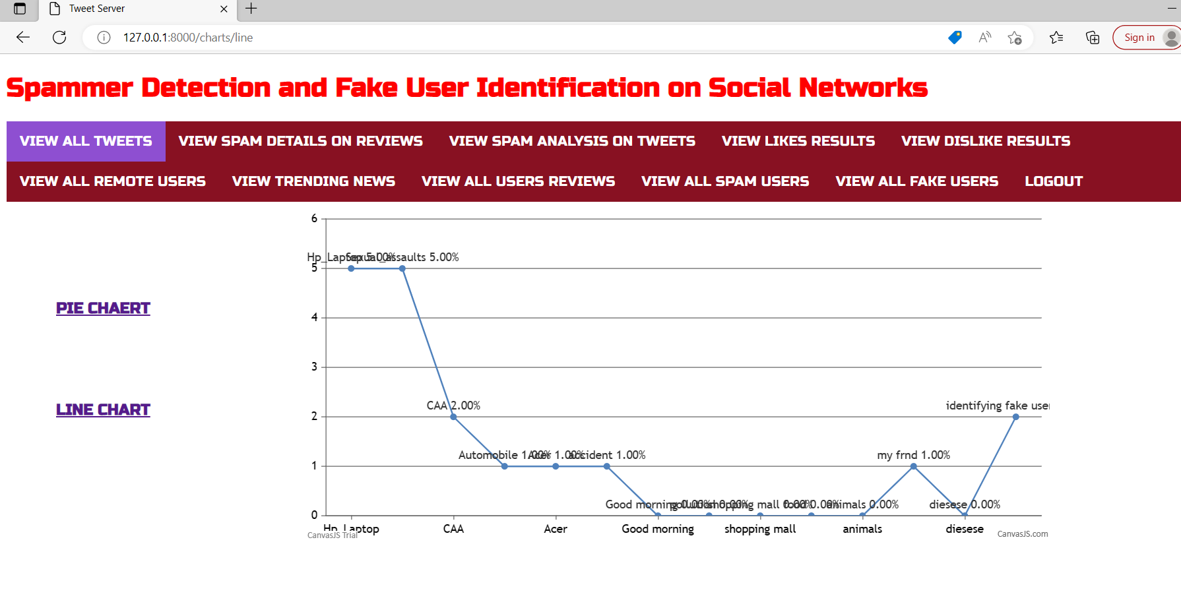

Slide 24
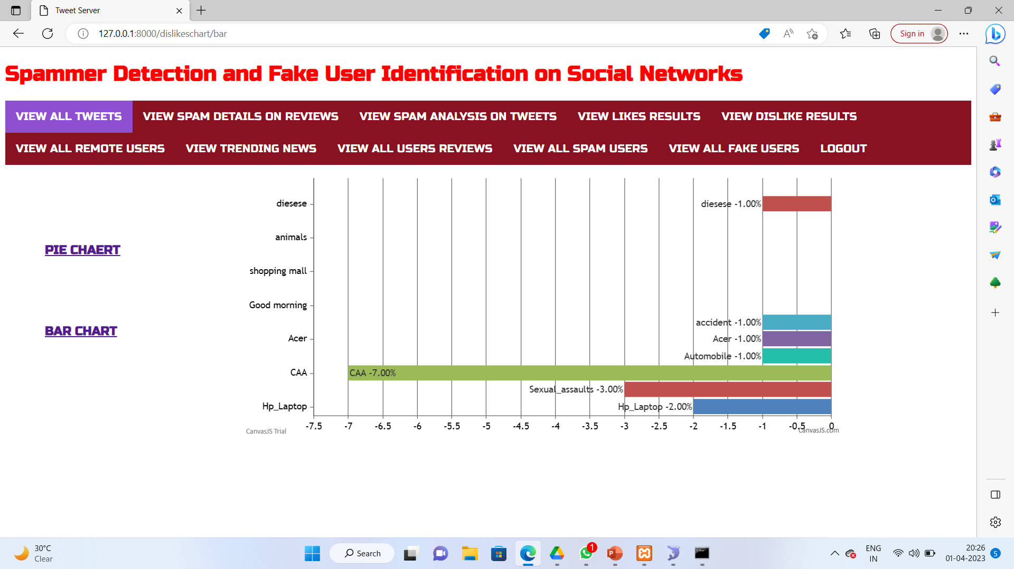

Slide 25
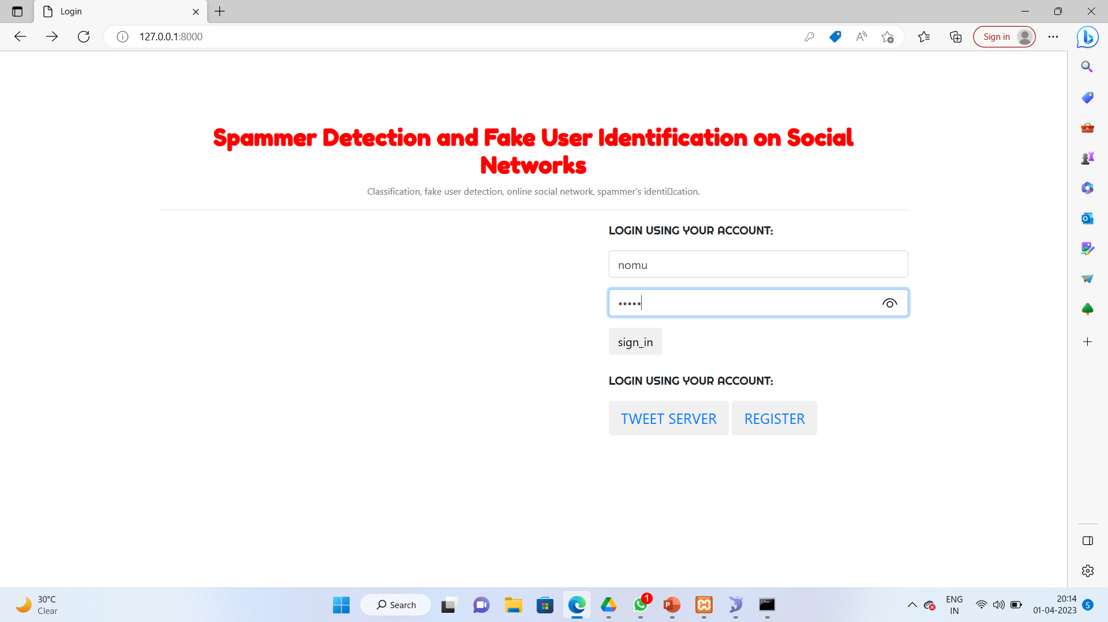

Slide 26
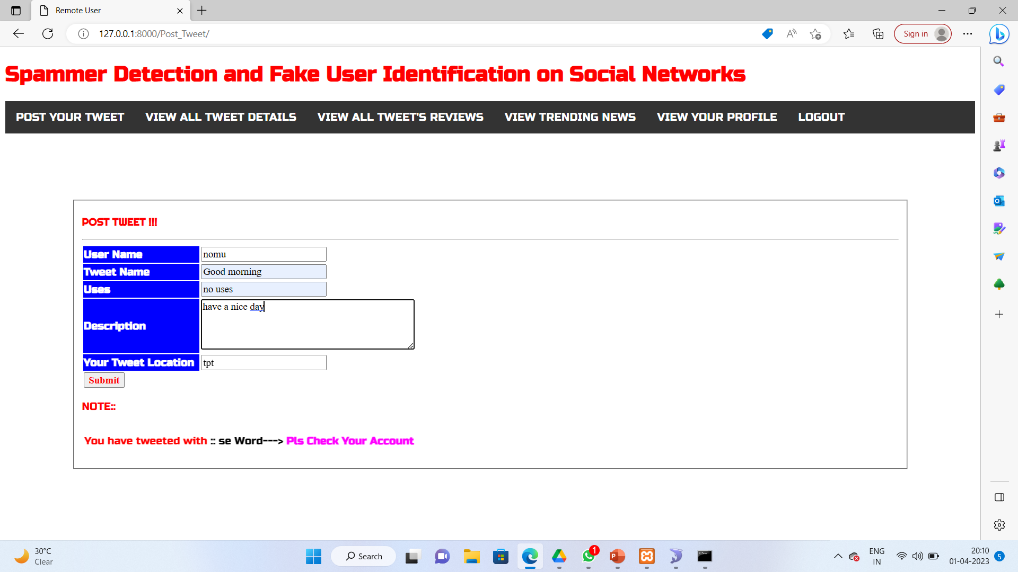

Slide 27
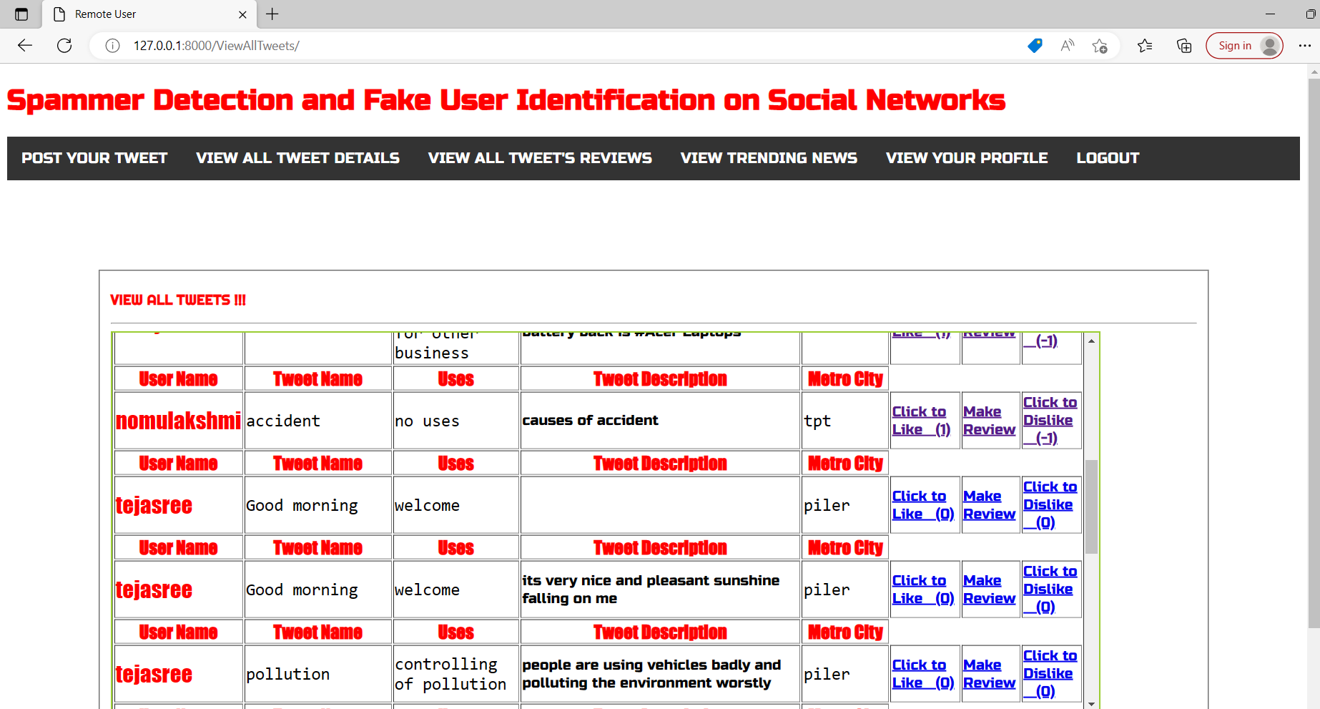

Slide 28
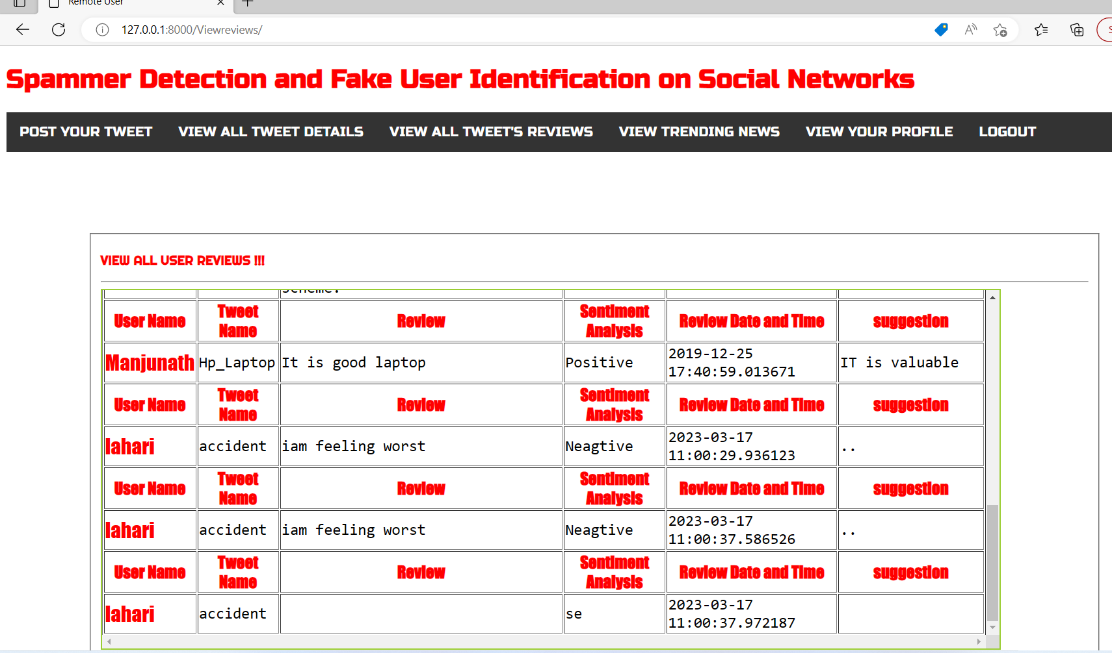

Slide 29
CONCLUSION
Twitter spam detection approaches and categorised them as fake content detection,URL based spam detection ,spam in trending topics ,and fake user detetion techniques
It is anticipated that the presented review will help researchers and the information on state of the art Twitter spam detection tecniques in a consolidated form.
Another associated topic that is worth investigating is te identification of rumour sources on social media.
Although a few studies based on statistical methods have already been conducted to detect the sources of rumours more sophisticated approaches eg : social networks based approaches , can be applied because of the proven effectiveness.

Slide 30
REFERENCES
[1] B. Erfahin, O. Akta³, D. Kilinf, and C. Akyol, "Twitter fake account detection," in Proc. Int. Conf. Comput. Sci. Eng. (UBMK), Oct. 2017, pp. 388_392.
[2] F. Benevenuto, G. Magno, T. Rodrigues, and V. Almeida, ''Detecting spammers on Twitter," in Proc. Collaboration, Electron. Messaging, Anti- Abuse Spam Conf. (CEAS), vol. 6, Jul. 2010, p. 12.
[3] S. Gharge, and M. Chavan, ''An integrated approach for malicious tweets detection using NLP," in Proc. Int. Conf. Inventive Commun. Comput. Technol. (ICICCT), Mar. 2017, pp. 435_438.
[4] T. Wu, S. Wen, Y. Xiang, and W. Zhou, ''Twitter spam detection: Survey of new approaches and comparative study," Comput. Secur., vol. 76, pp. 265_284, Jul. 2018.
[5] S. J. Soman, ''A survey on behaviors exhibited by spammers in popular social media networks," in Proc. Int. Conf. Circuit, Power Comput. Tech- nol. (ICCPCT), Mar. 2016, pp. 1_6.

Slide 31


